Slide 1

FedDANN
Non-generative adversarial learning for federated settings
319029 Florentin-Cristian Udrea
314908 Bruno Spaccavento
317680 Claudio Savelli
MLDL 2022/2023
Notes:
Good morning, in today's presentation we are going to propose an adaptation of the well-known adversarial learning technique DANN to the Federated scenario as a possible domain generalisation solution.

Slide 2
Introduction
Notes:
Before we begin, however, I would like to make a brief introduction to the federated learning framework and the problems connected to it

Slide 3
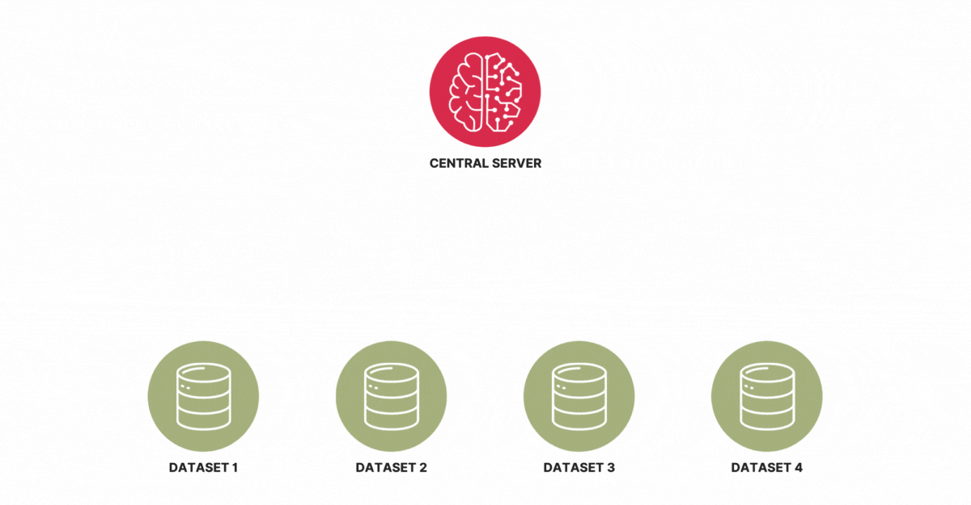
Federated Learning – What and Where?
Federated learning (FL) is a machine learning paradigm in which multiple clients cooperate to learn a model under the orchestration of a central server.
Local training datasets are never uploaded to the server!
Notes:
As you can see from the definition here, (...). In fact, the goal of federated learning is to move the training phase of a model from a single centralised server to a distributed framework.

Slide 4

Federated Learning – Why?
Data is often generated by billions of edge devices: Mobile Phones, IoT sensors, Hospitals or medical devices, Vehicles...
But usually all these data are inaccessible due to privacy concern and because it’s impossible to transfer them all to a centralised server.
Necessity to learn from data at the edge!
Notes:
This is why there is a need to learn from data at the edges

Slide 5
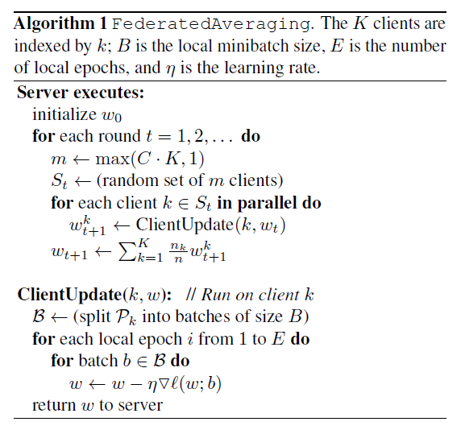
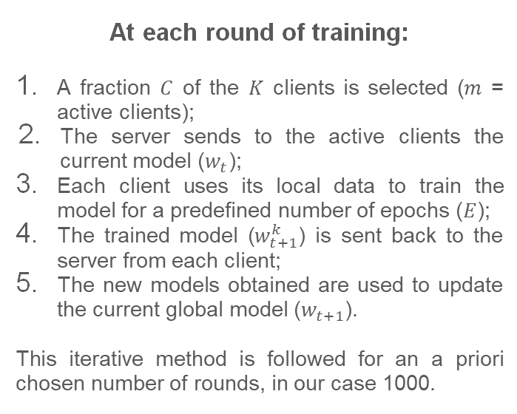
Federated Learning – How? FedAvg
At each round of training:
A fraction $C$ of the $K$ clients is selected ($m$ = active clients);
The server sends to the active clients the current model ($w_{t}$);
Each client uses its local data to train the model for a predefined number of epochs ($E$);
The trained model ($w_{t+1}^{k}$) is sent back to the server from each client;
The new models obtained are used to update the current global model ($w_{t+1}$).
This iterative method is followed for an a priori chosen number of rounds, in our case 1000.
Notes:
To better understand how federated learning works algorithmically, I will now briefly explain the most famous federated method: FedAvg. We have a centralised server with a model to train. The training is divided into rounds. In each training round, the server iteratively performs the following actions:

Slide 6

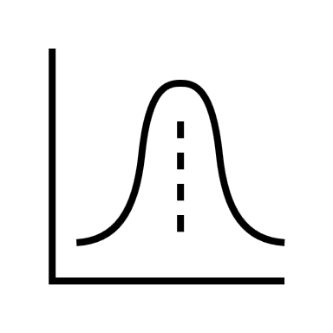
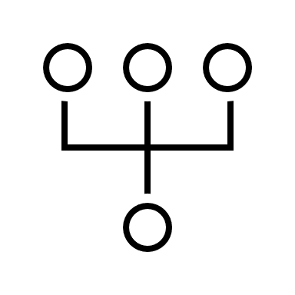
Problems considered with FedDANN
Due to the nature of this framework, several new challenges are assessed. Listed here are the three main ones considered within the paper:
Privacy and Security
Main reason behind the creation of this paradigm. There are legal and privacy concerns that prevent to access data in general, especially the sensitive ones (GDPR).
Statistical Heterogeneity
The presence of variations
in the data distributions across different domains or
clients in a federated learning setting. They may be of different natures.
Domain Generalisation
Related to the Statistical Heterogeneity problem, the model must be able to generalise to domains outside the federation that has never been seen before.
Notes:
keep data on the edge, without ever accessing them.
another of the fundamental problems of this framework.
Problem related to Statistical Heterogeneity

Slide 7


Problems considered with FedDANN
Due to the nature of this framework, several new challenges are assessed. Listed here are the three main ones considered within the paper:
Privacy and Security
Main reason behind the creation of this paradigm. There are legal and privacy concerns that prevent to access data in general, especially the sensitive ones (GDPR).
Statistical Heterogeneity
The presence of variations
in the data distributions across different domains or
clients in a federated learning setting. They may be of different natures.
Domain Generalisation
Related to the Statistical Heterogeneity problem, the model must be able to generalise to domains outside the federation that has never been seen before.
Notes:
Let’s see in detail the last two problems, central in our discussion.
Read until different domain or clients.

Slide 8
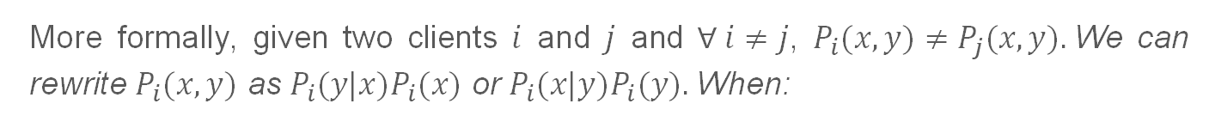
Examples
More formally, given two clients $i$ and $j$ and $∀ i≠j$, $P_{i}(x,y)≠P_{j}(x,y).$We can rewrite $P_{i}(x,y)$ as $P_{i}(y|x)P_{i}(x)$ or $P_{i}(x|y)P_{i}(y).$When:
Notes:
Bayes rule / Conditional Probability
for reasons of time I will only show you one of the examples listed here

Slide 9


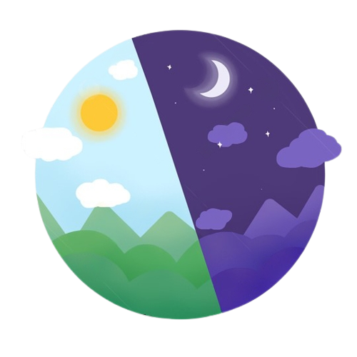
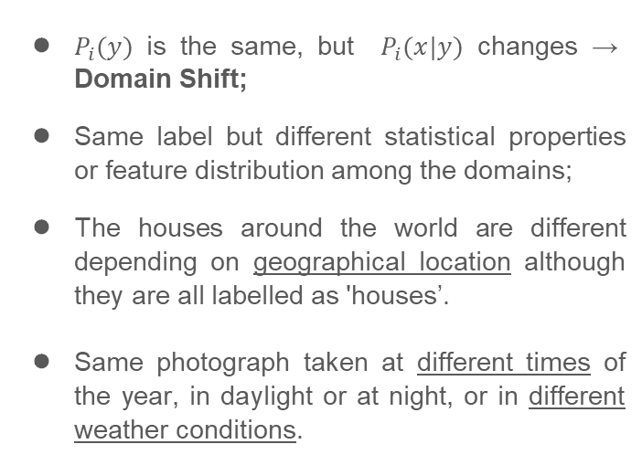
Examples
More formally, given two clients $i$ and $j$ and $∀ i≠j$, $P_{i}(x,y)≠P_{j}(x,y).$We can rewrite $P_{i}(x,y)$ as $P_{i}(y|x)P_{i}(x)$ or $P_{i}(x|y)P_{i}(y).$When:
$P_{i}(y)$ is the same, but $P_{i}(x|y)$ changes → Domain Shift;
Same label but different statistical properties or feature distribution among the domains;
The houses around the world are different depending on geographical location although they are all labelled as 'houses’.
Same photograph taken at different times of the year, in daylight or at night, or in different weather conditions.
Notes:
As we can see there(in P_i(x|y), the relationship between the input features and the target variable may change between domains.
In summary, feature shift refers to differences in the input features or characteristics, while domain shift refers to differences in the overall data distribution or data generation process between domains.

Slide 10

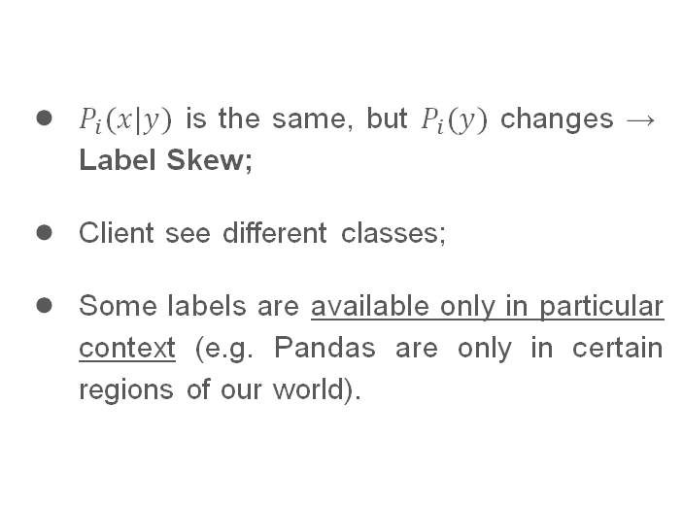
Examples
More formally, given two clients $i$ and $j$ and $∀ i≠j$, $P_{i}(x,y)≠P_{j}(x,y).$We can rewrite $P_{i}(x,y)$ as $P_{i}(y|x)P_{i}(x)$ or $P_{i}(x|y)P_{i}(y).$When:
$P_{i}(x|y)$ is the same, but $P_{i}(y)$ changes → Label Skew;
Client see different classes;
Some labels are available only in particular context (e.g. Pandas are only in certain regions of our world).
Notes:
Let us imagine that we want to classify images of animals, obviously depending on the geographical area the animals photographed will probably be different, and many only exist in certain regions.

Slide 11
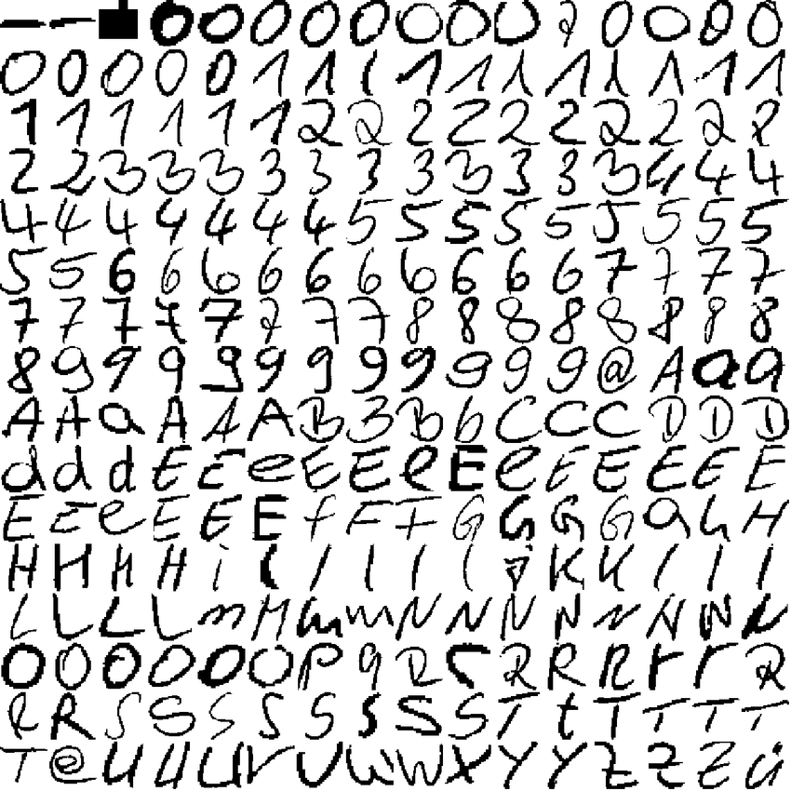
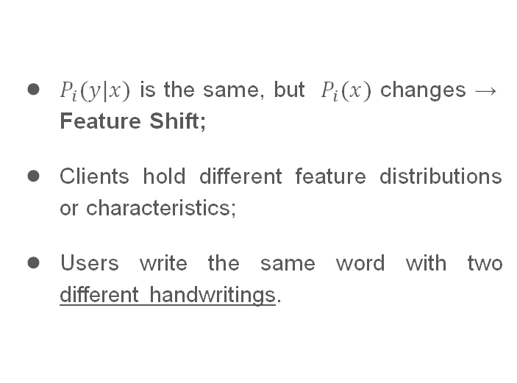
Examples
More formally, given two clients $i$ and $j$ and $∀ i≠j$, $P_{i}(x,y)≠P_{j}(x,y).$We can rewrite $P_{i}(x,y)$ as $P_{i}(y|x)P_{i}(x)$ or $P_{i}(x|y)P_{i}(y).$When:
$P_{i}(y|x)$ is the same, but $P_{i}(x)$ changes → Feature Shift;
Clients hold different feature distributions or characteristics;
Users write the same word with two different handwritings.
Notes:
We may have the same labels, but the features that characterise these labels may change between clients, imagine for example different handwriting

Slide 12
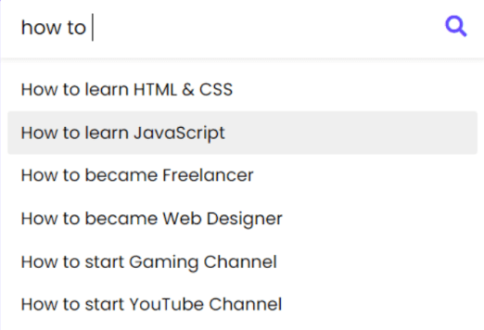
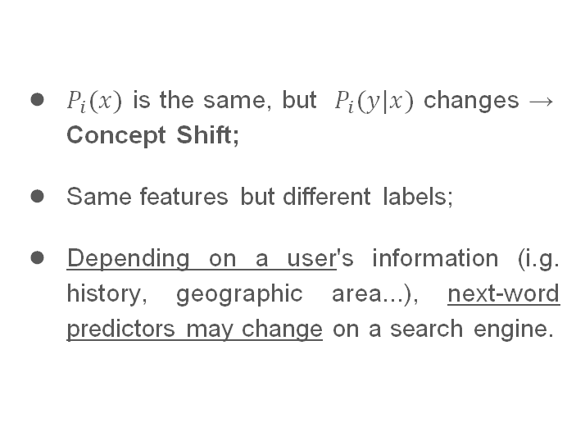
Examples
More formally, given two clients $i$ and $j$ and $∀ i≠j$, $P_{i}(x,y)≠P_{j}(x,y).$We can rewrite $P_{i}(x,y)$ as $P_{i}(y|x)P_{i}(x)$ or $P_{i}(x|y)P_{i}(y).$When:
$P_{i}(x)$ is the same, but $P_{i}(y|x)$ changes → Concept Shift;
Same features but different labels;
Depending on a user's information (i.g. history, geographic area...), next-word predictors may change on a search engine.

Slide 13
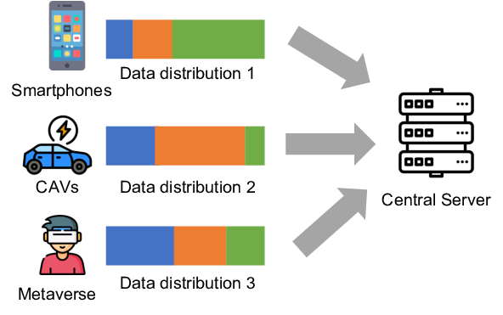
Statistical Heterogeneity Problem
Statistical Heterogeneity can adversely affect the performance and generalization capability of the federated learning model, as:
It can introduce bias and unfairness in the model, favouring domains with more representation;
Can result in poor generalisation as the model struggles to capture common patterns across diverse domains and devices.
Notes:
This heterogeneity can introduce several challenges and problems in federated learning such as

Slide 14
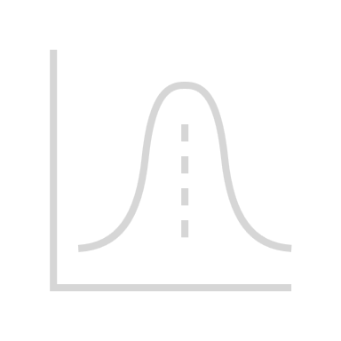
Problems considered with FedDANN
Due to the nature of this framework, several new challenges are assessed. Listed here are the three main ones considered within the paper:
Privacy and Security
Main reason behind the creation of this paradigm. There are legal and privacy concerns that prevent to access data in general, especially the sensitive ones (GDPR).
Statistical Heterogeneity
The presence of variations
in the data distributions across different domains or
clients in a federated learning setting. They may be of different natures.
Domain Generalisation
Related to the Statistical Heterogeneity problem, the model must be able to generalise to domains outside the federation that has never been seen before.
Notes:
Now that the general problem of statistical heterogeneity has been introduced, let us look at a specific subproblem of the latter, domain generalisation.

Slide 15
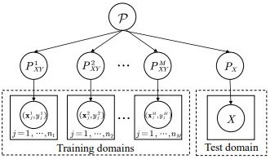
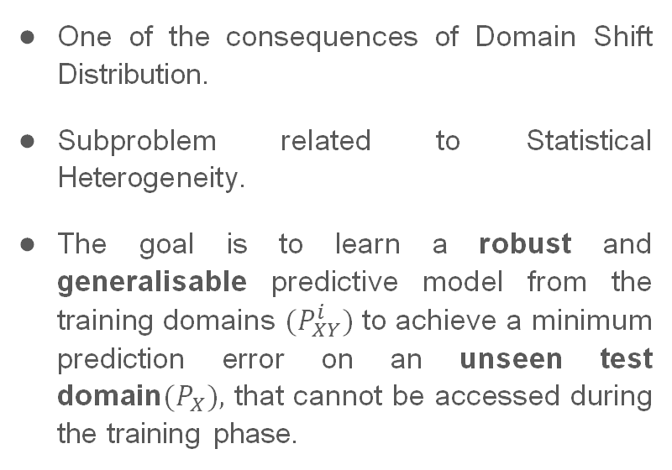
Definition
One of the consequences of Domain Shift Distribution.
Subproblem related to Statistical Heterogeneity.
The goal is to learn a robust and generalisable predictive model from the training domains ${(P}_{XY}^{i})$ to achieve a minimum prediction error on an unseen test domain$(P_{X}),$ that cannot be accessed during the training phase.
Notes:
In domain generalisation, our goal is to be able to have a model capable of classifying, with a certain accuracy, domains never seen in the training phase, and so to learn a robust and generalizable predictive model.

Slide 16
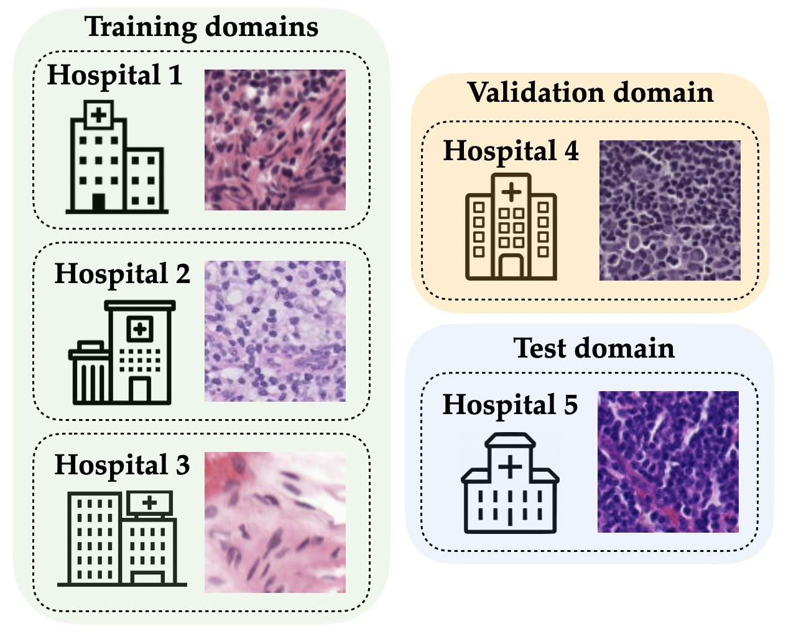
Domain Generalisation in Federated Setting
In federated learning each client typically represents a different domain, such as different hospitals, companies, or geographical regions.
Since the distribution of data may differ across different domains, models must generalise across domains without retraining every time a new one appear.
Notes:
Between 1 and 2) Importantly, as we can see there, domains can also change as the acquisition methods used to obtain the data change.

Slide 17

Challanges
Most of the actual DG methods require a centralised setting where data is shared across the domains.
This violates the principles of Federated Learning framework.
The model never sees two different domains (clients) at the same time, which makes this problem quite unique.

Slide 18
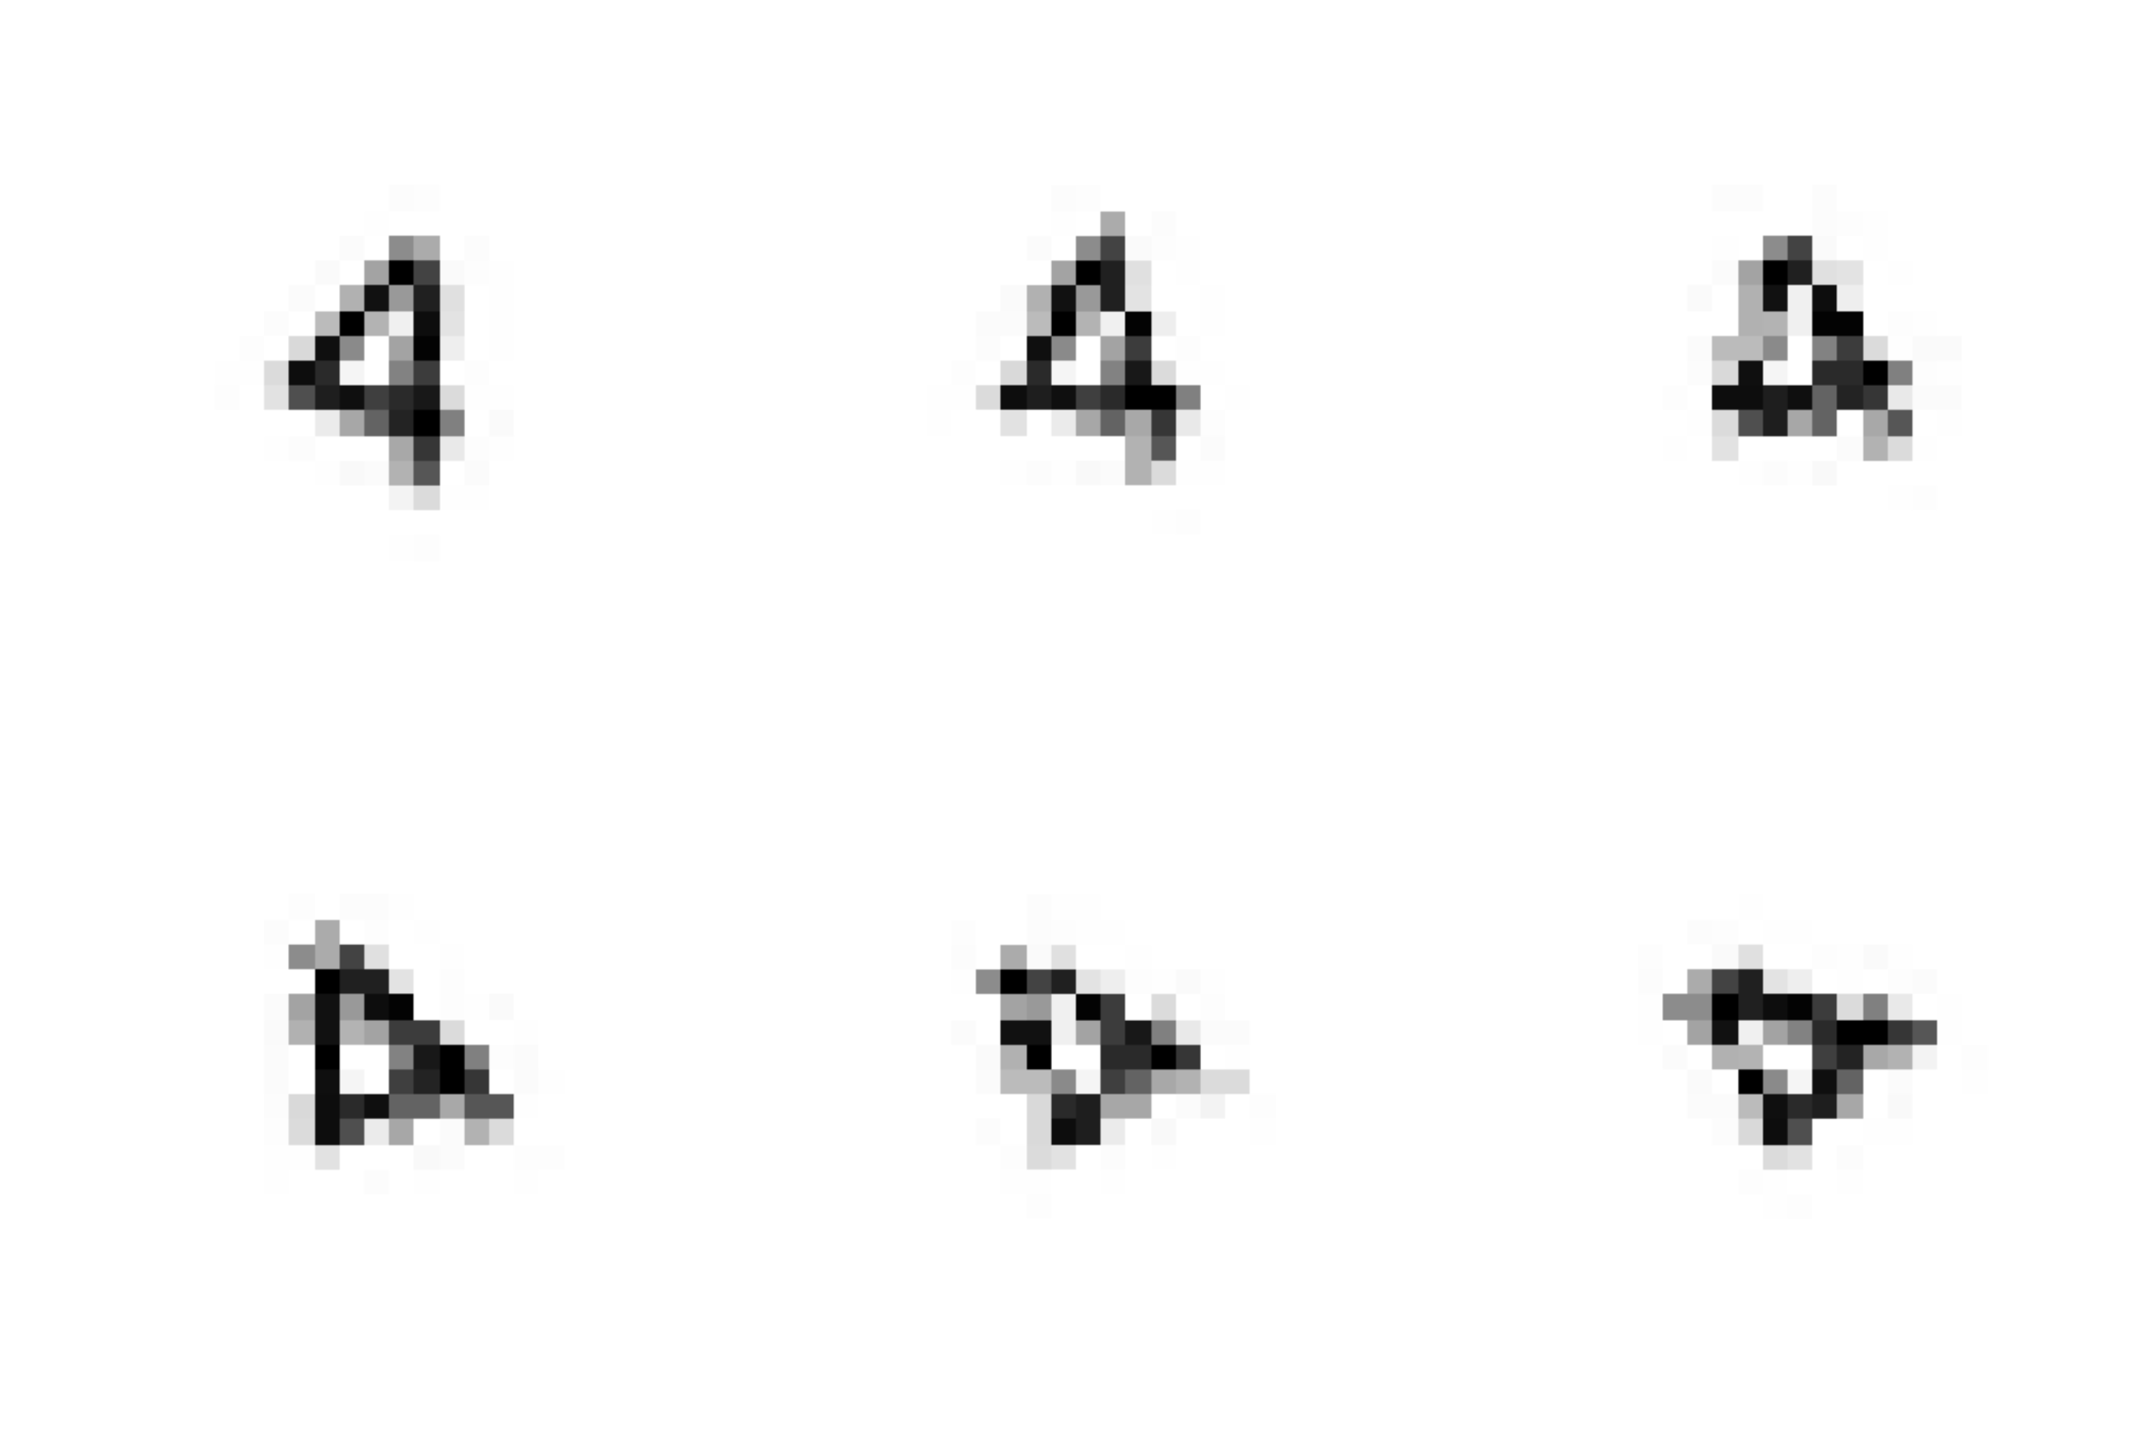
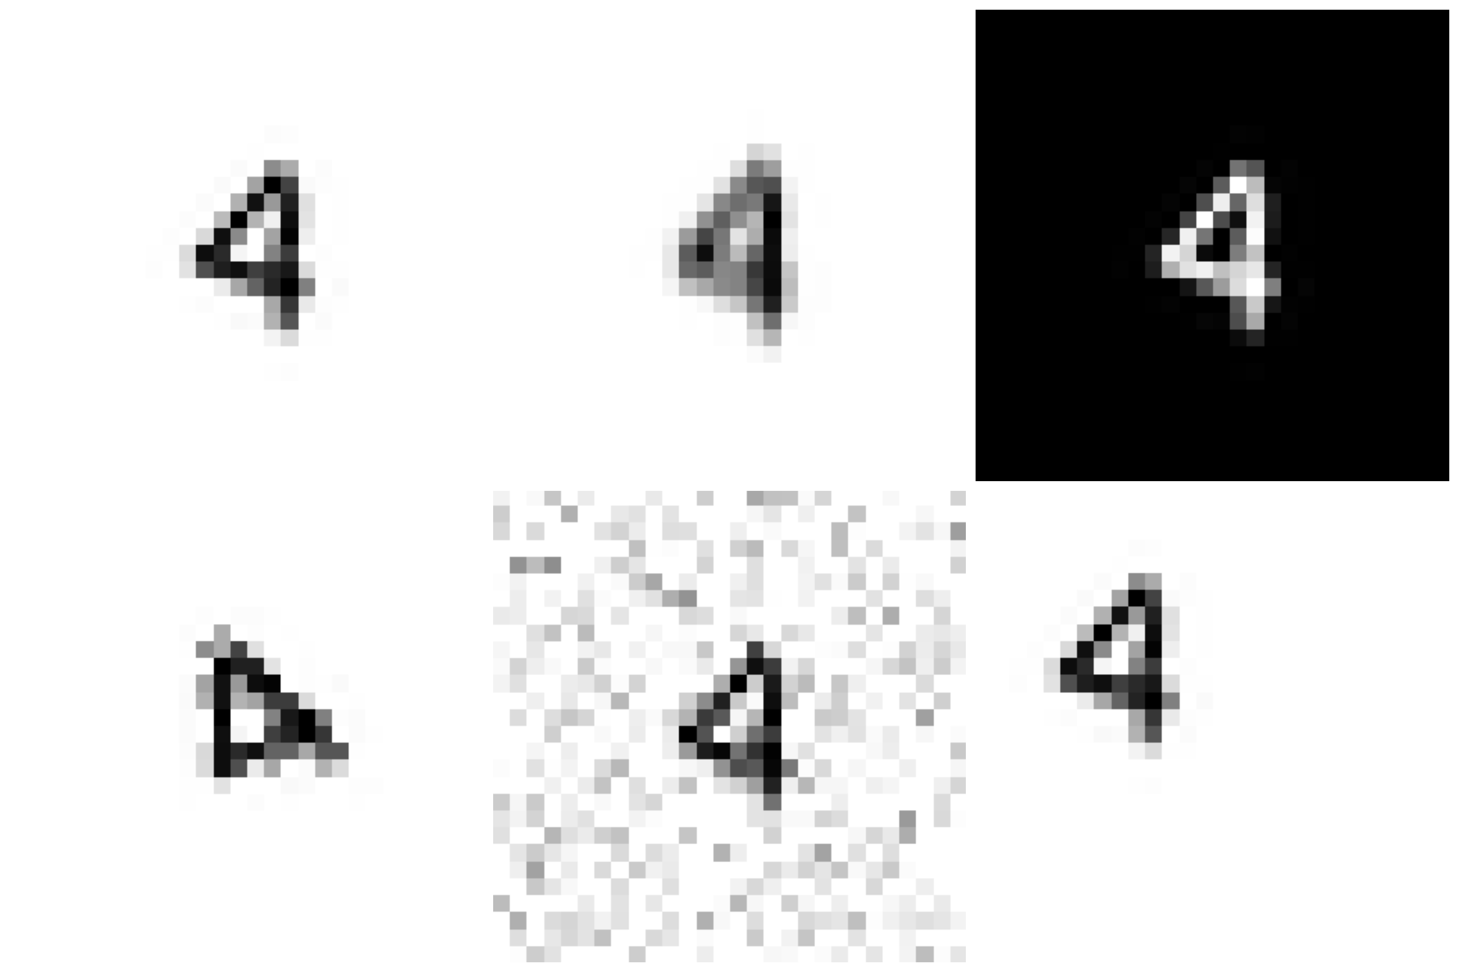
Dataset Used to experiment Domain Generalisation
RotatedFEMNIST
DGFEMNIST
Notes:
Therefore, to replicate the domain generalisation problem, we used these two datasets to make the domain shifts even more defined.
The first is the well-known RotatedFEMNIST, often used in this framework, in which each domain is assigned a rotation between 0 and 75 degrees.
Considering that during the experiments the use of RotatedFEMNIST often gave similar results to normal FEMNIST, since the shift domain between one domain and the other is relatively low especially for the first rotations, it was decided to create a new set of transformations for a new dataset that could generate sharper shift domains, this is how DGFEMNIST is born.

Slide 19
Our work
Notes:
I will now give the word to Bruno who will describe in detail the experiments we carried out.

Slide 20
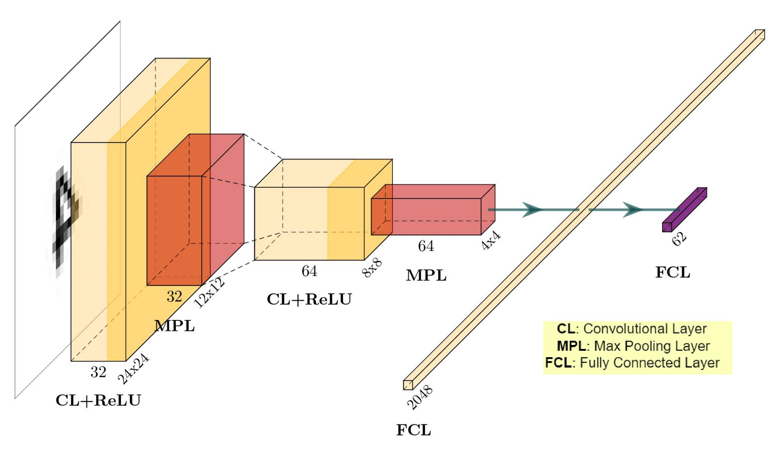
Convolutional Neural Network used for experiments

Slide 21
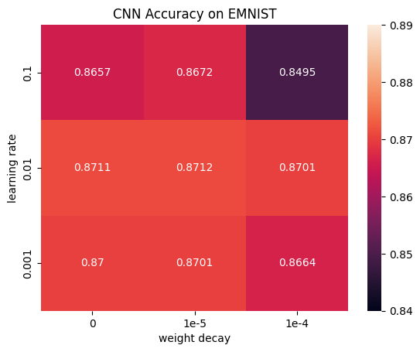
Hyperparameter Tuning – Centralised Problem (EMNIST)
The first objective is to have a baseline for the centralized framework using EMNIST.
After the hyperparameter tuning phase, the selected values are lr = 0,01 and
wd = 1e-5, with an accuracy obtained of 0,8712.

Slide 22
Hyperparameter Tuning – FEMNIST
After hyperparameter tuning with the centralised Emnist, the following hyperparameters were selected for our experimentation in Federated:
For clients:
Learning rate: 0.1
Momentum: 0.9
Batch Size: 64
Weight Decay: 1e-4
For server:
Learning rate: 1
Momentum: 0
For this part of the experiment to reproduce the normal FedAvg.
We will then see its actual usefulness when we talk about server momentum in Statistical Heterogeneity!

Slide 23
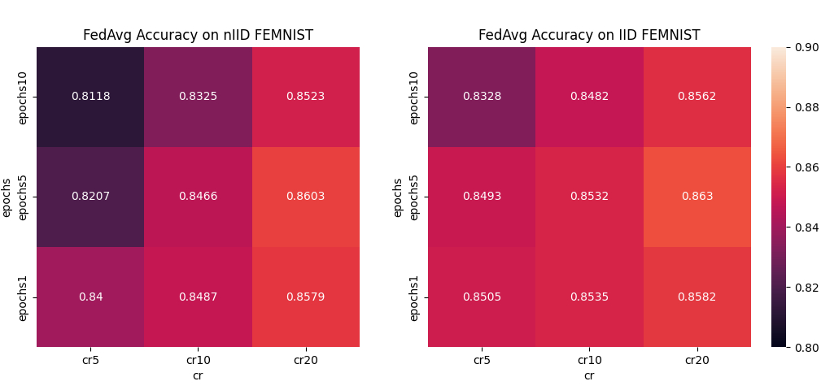
Hyperparameter Tuning – Clients per Round and Local Epochs
The objective now is to find a correct tradeoff between accuracy obtained in the result,
the amount of data sent to the server (∝ clients per round (cr)) and
the computational cost of the devices (∝ number of local epochs (ne)).

Slide 24
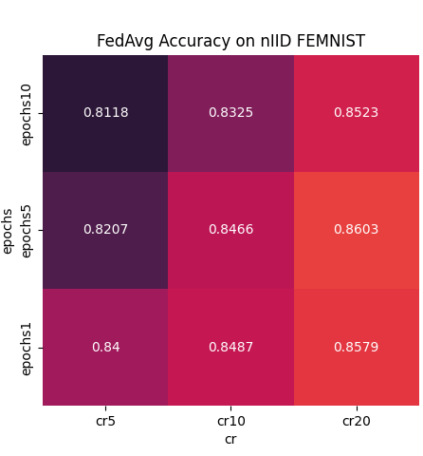
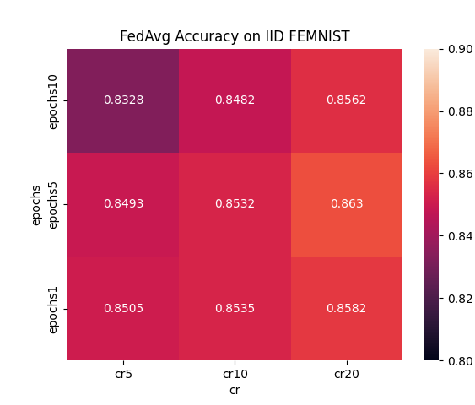
Hyperparameter Tuning – Clients per Round and Local Epochs
Clients per Round:
Higher is better!
Accuracy(cr) ∝ log(cr);
Tradeoff between accuracy and communication per round (cr = 10 is selected).
Local Epochs:
Higher is not always better!
Low number of data points for each individual client, each epoch has a great influence on the SGD step!
Tradeoff between accuracy and computational cost for each device (ne = 1 is selected).

Slide 25
Statistical Heterogeneity Power-of-choice

Slide 26

Smart client selection with Power-of-choice
FedAvg chooses a fixed number of client randomly per round;
Smart client selection chooses the clients per round in a biased way:
Server picks d (m≤d≤k) clients without replacement;
Sends them the current model, the clients then send back to the server their loss functions;
Chooses the m clients with the highest loss function;
Trains the model using these m clients.
Power-of-choice is proved to achieve faster error convergence, yet choosing high values of d can lead to a non-negligible higher error floor.

Slide 27

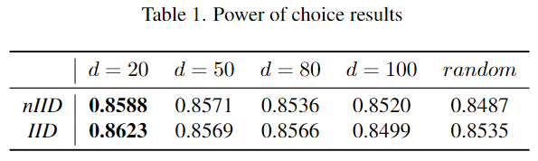
Power-of-choice results
m = 10, fixed;
d = {20, 50, 80, 100};
With d = 20, performance increases by +1% in both IID and nIID scenarios.

Slide 28
Statistical Heterogeneity Server-side momentum

Slide 29
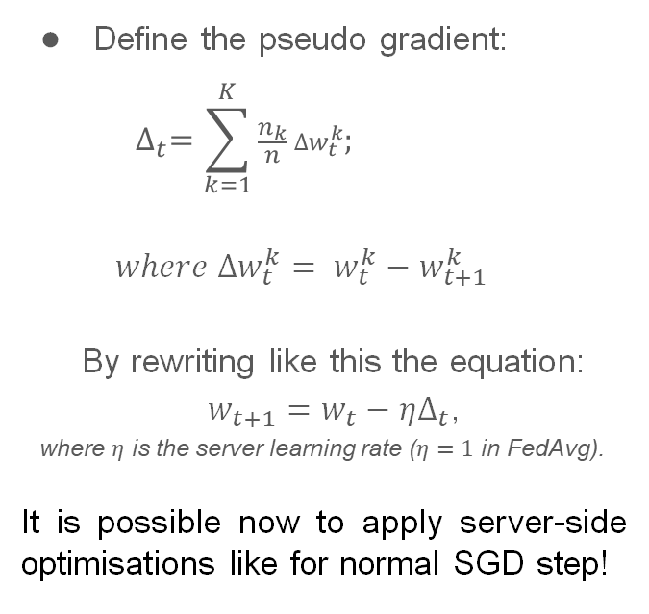
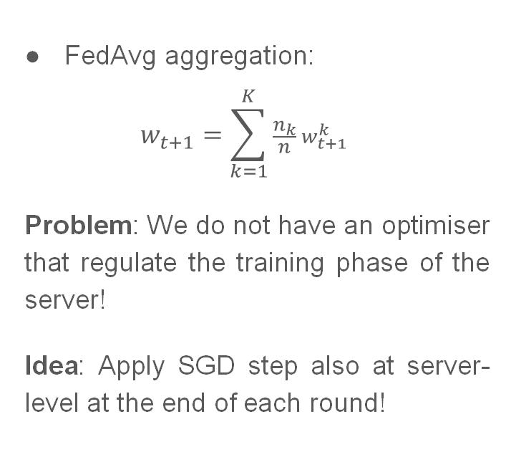
Aggregation Function – A look in detail
FedAvg aggregation:
$$w_{t+1}=\sum_{k=1}^{K}{\frac{n_{k}}{n}{ w}_{t+1}^{k}}$$
Problem: We do not have an optimiser that regulate the training phase of the server!
Idea: Apply SGD step also at server-level at the end of each round!
Define the pseudo gradient:
$$∆_{t}=\sum_{k=1}^{K}{\frac{n_{k}}{n} ∆w_{t}^{k}; }$$
$$where ∆w_{t}^{k}={{ w}_{t}^{k} − w}_{t+1}^{k}$$
By rewriting like this the equation:
$w_{t+1}=w_{t}−η∆_{t}$,
where $η$ is the server learning rate ($η=1$ in FedAvg).
It is possible now to apply server-side optimisations like for normal SGD step!

Slide 30
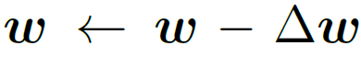
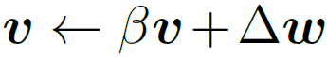
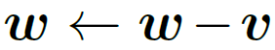
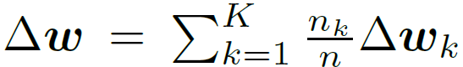
Server side momentum
Why use server side momentum?
Accelerates network training;
Dampens the effects of statistical heterogeneity;
Without server side momentum:
where
With server side momentum:
where

Slide 31
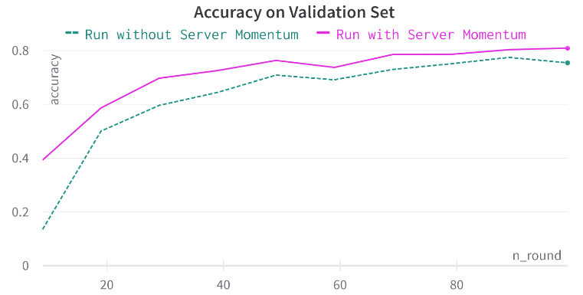
Server side momentum results
β = {0.5, 0.6, 0.7, 0.9} → best choice β = 0.6;
Test accuracy improvement at the end of 1000 rounds: 0.859 vs 0.849 (+1%);
Faster convergence speed:
only the first 100 rounds;
accuracy on validation test computed every 10 rounds;
Accuracy at the end of the first 100 rounds: 0.807 vs 0.755 (+5.2%)

Slide 32
Domain Generalisation

Slide 33
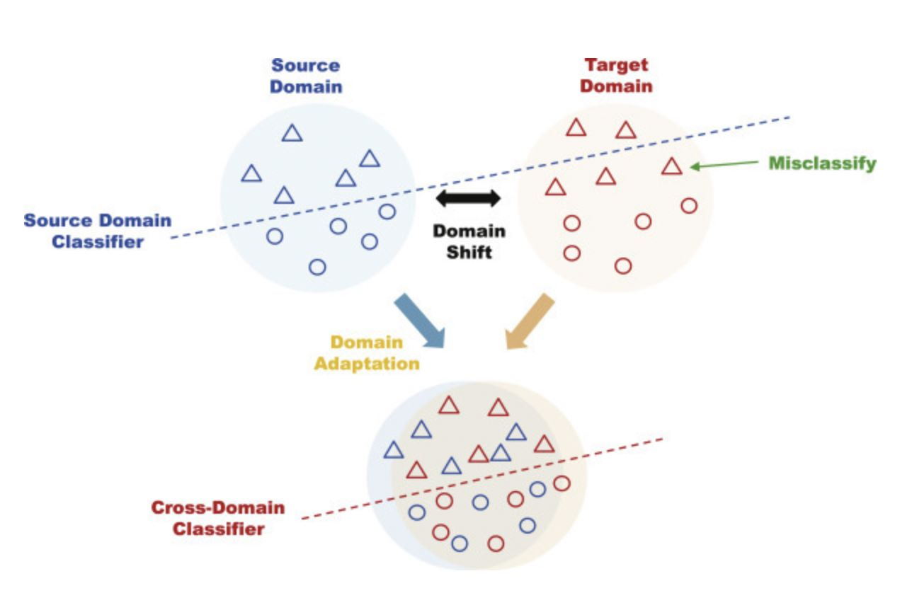
Domain Generalisation: brief review
We have different X (input) distributions, yet same Y (label) distribution
In Domain Generalisation (DG) we never see the target distribution during training
We want to perform well on both source and target distributions

Slide 34
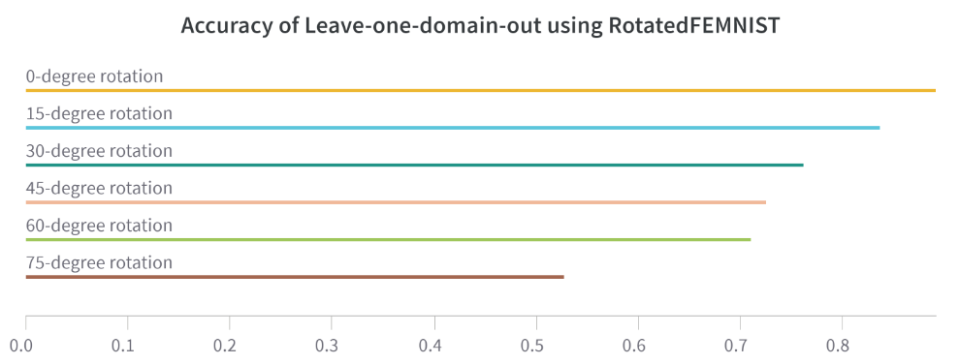
Leave-one-domain-out approach
Applied on RotatedFEMNIST and DGFEMNIST;
Take one domain out;
Apply train, validation and test phases on the remaining dataset;
Apply a second test phase on the leftout domain;
Higher accuracy when the domain is ’similar’ to those used in the training, and lower ones moving away from the domains used in the training.

Slide 35
Domain Generalisation FedSR

Slide 36

FedSR: Simple Representation for DG
Regularise the representation in order to be domain-agnostic

Slide 37
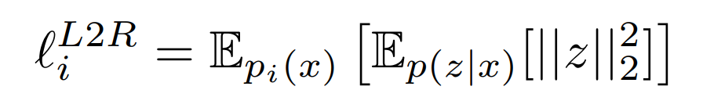
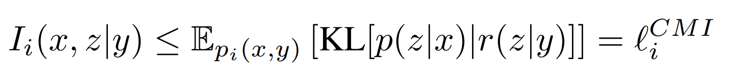
FedSR: Simple Representation for DG
L2-norm regulariser
CMI regulariser
Two interpretations:
Penalises having many parameters
Forces to have only essential information
Penalises being distant from the origin
Forces to center around the origin
Enforces the representation to only contain​
Information about the label to be predicted.
Notes:
Mi : correlazione tra 2 distribuzioni
CMI: correlazione tra 2 distribuzioni dipendenti da un’altra distribuzione

Slide 38
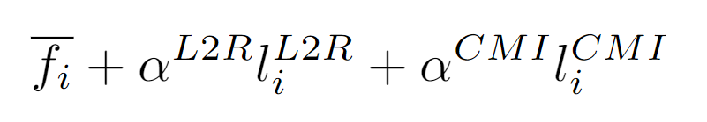
FedSR: Simple Representation for DG
L2-norm regulariser
CMI regulariser
Regularised problem:

Slide 39
Domain Generalisation FedDANN

Slide 40
FedDANN: Idea
Build a representation that:
Contains label information
Domain-invariant
How ? → Apply the DANN architecture to the federated problem.
DANN doesn't need to share information across clients​
Why ? → Simple, yet effective​.
Proven to work in both DA and DG​.

Slide 41
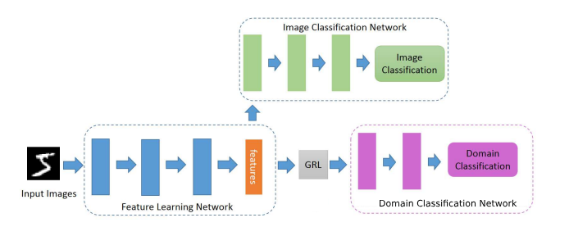
DANN: Domain adversarial regularisation
In practice:
Second branch for domain classification,
Connect it trough gradient reversal layer (GRL),
'Punish' the correctness of the domain classifier as it shows domain information in the features.​

Slide 42
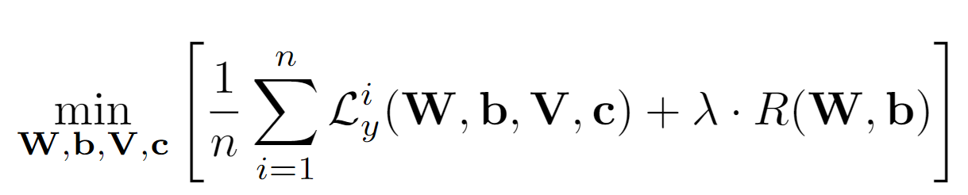
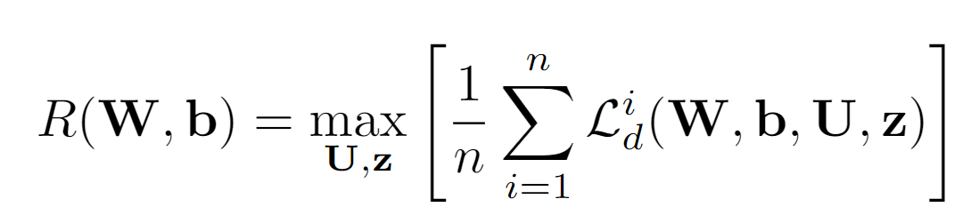
DANN: Domain adversarial regularisation
Mathematically:
↑ ↑
Label classifier Domain
Loss Regulariser
↑
Domain classifier
Loss
( )
acts like a mean divergence measure between domain distributions
W, b → Feature Extractor Parameters
V, c → Label Classifier Parameters
U, z → Domain Classifier Parameters

Slide 43
DANN needs domain labels
One drawback of this method is it needs domain labels
Yet they can be easily found in many scenarios

Slide 44

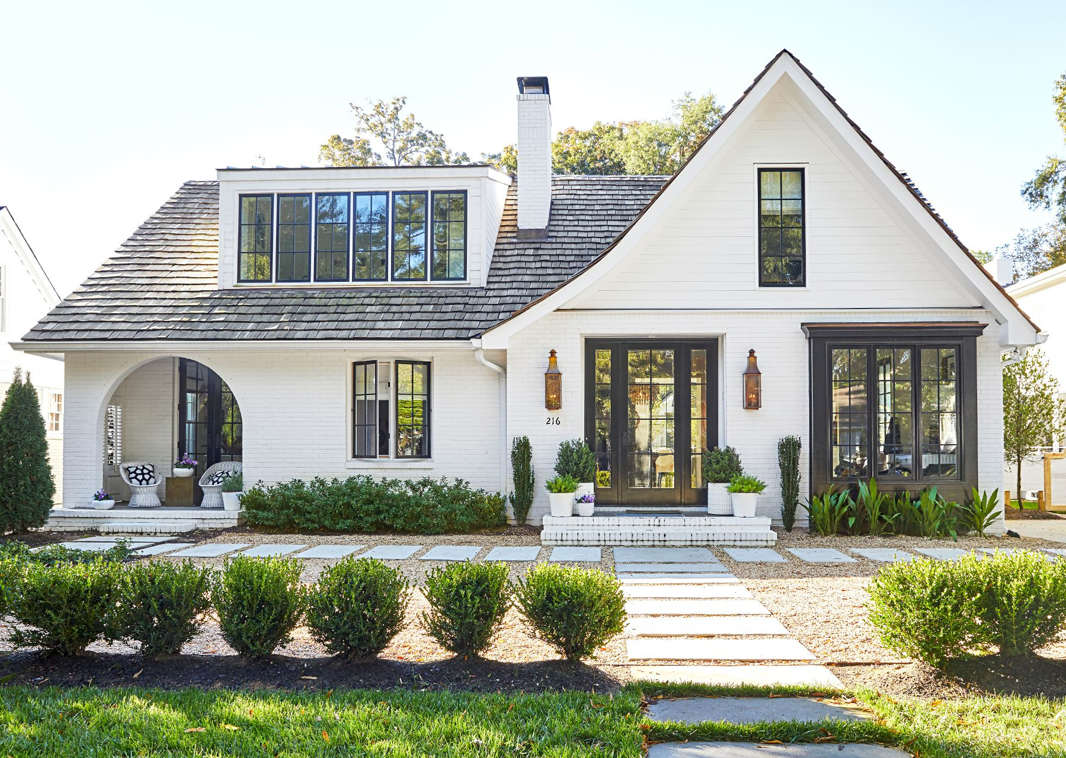
DANN needs domain labels
One drawback of this method is it needs domain labels
Yet they can be easily found in many scenarios
By location:

Slide 45
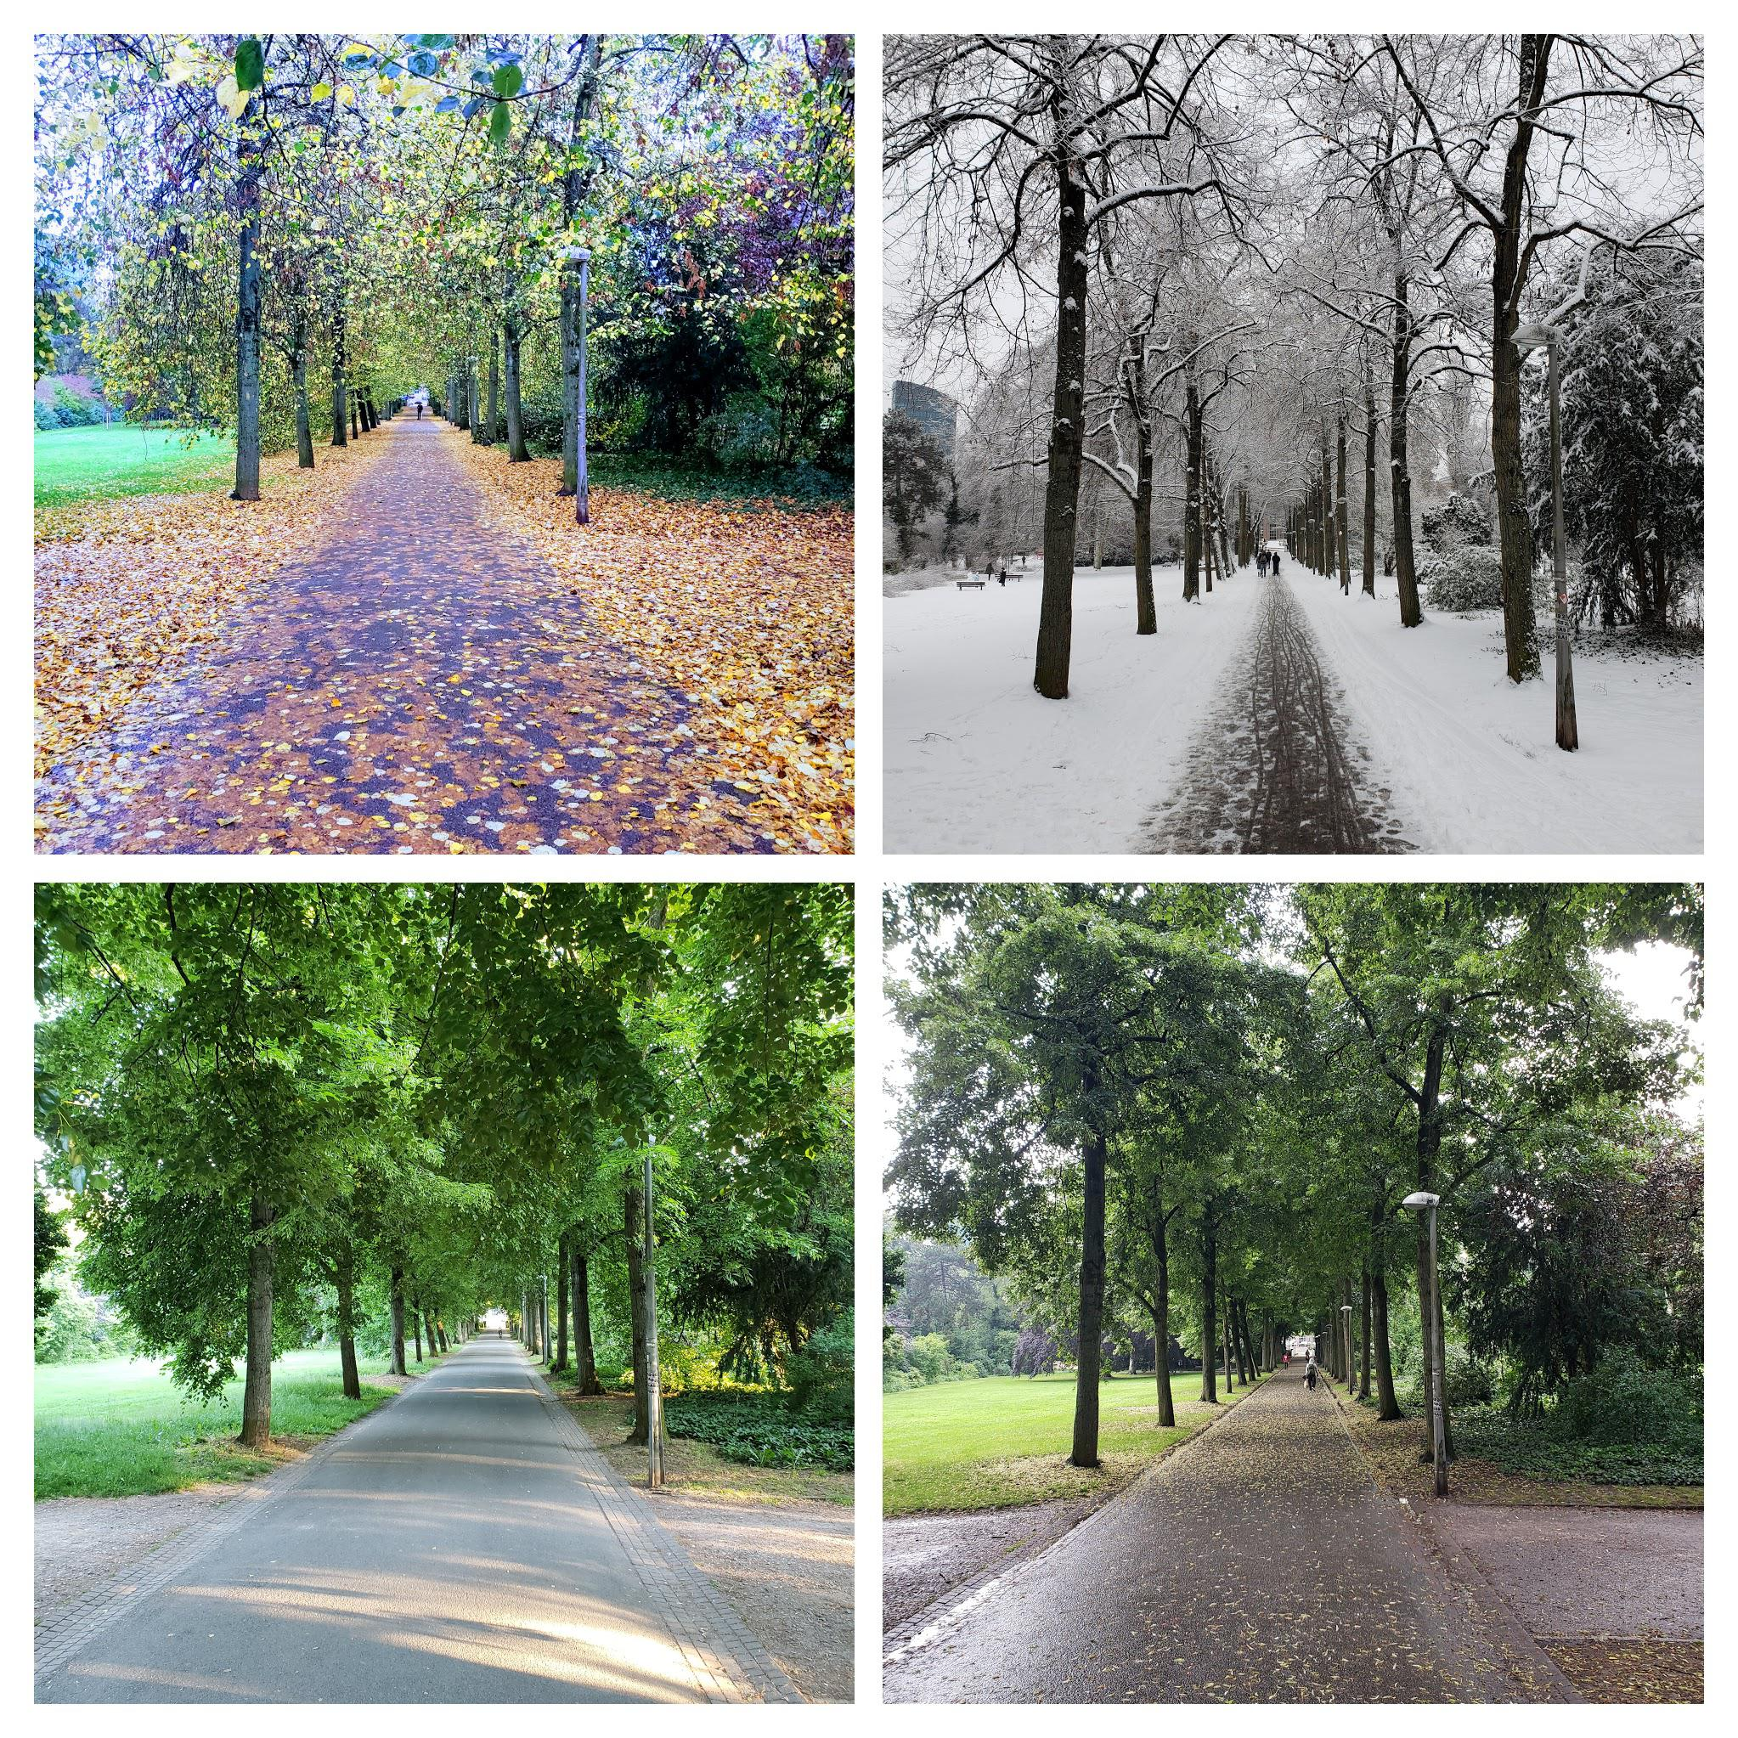
DANN needs domain labels
One drawback of this method is it needs domain labels
Yet they can be easily found in many scenarios
By season:

Slide 46
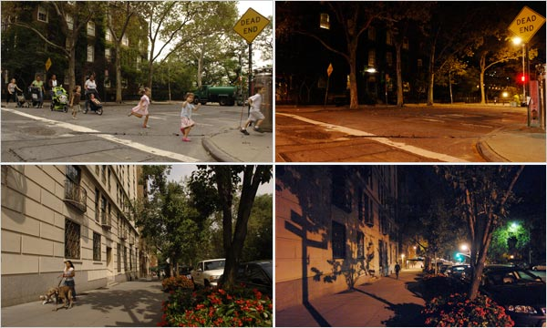
DANN needs domain labels
One drawback of this method is it needs domain labels
Yet they can be easily found in many scenarios
By time of the day:

Slide 47


DANN needs domain labels
One drawback of this method is it needs domain labels
Yet they can be easily found in many scenarios
By sensor:

Slide 48
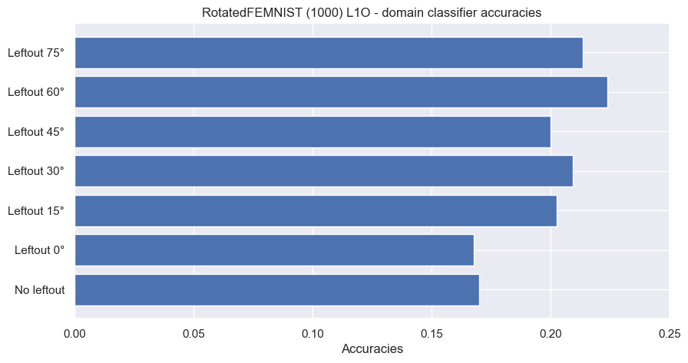
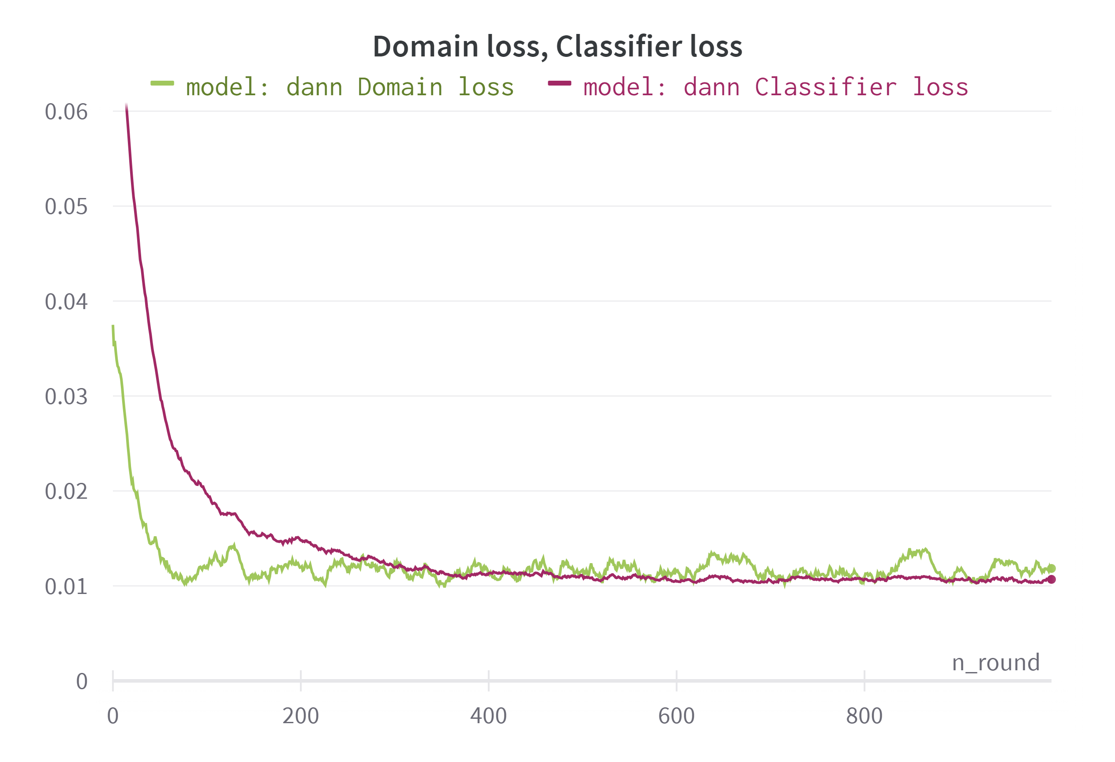
FedDANN: Results
We assessed our DANN worked:
Domain classifier accuracy is basically random:
≈ 0.2 for 5 domains
≈ 0.16 for 6 domains
Classifier loss → smoothly kept decreasing
Domain loss → inially decreased, then zigzag around a stable value
(both graphs are smoothed for readibility)

Slide 49
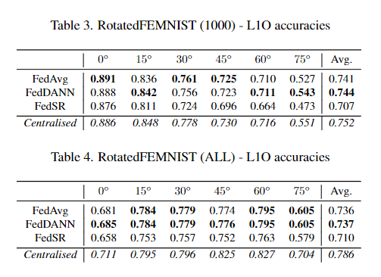
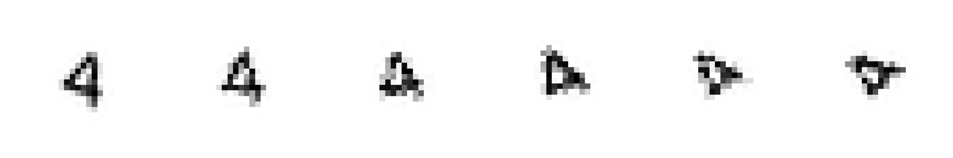
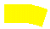
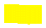
RotatedFEMNIST: Results and discussion
→ For 0° is almost data augmentation;
→ More distant from zero, worse performance.
→ ‘Central' domains have more overlap, thus perform better.

Slide 50




DGFEMNIST: Results and discussion
→ Better results with DGFEMNIST (greater distance between domains).
→ Having IID domain distribution among clients almost always helps.

Slide 51

To sum up
New dataset proposed: DGFEMNIST;
Implemented DANN in Federated framework;
Extensively tested several SOTA solutions for federated learning (600+ total runs on WandB, 1000 rounds each).
Conclusions...
Satisfactory results exceeding both the results obtained with FedAvg and FedSR;
Maintains client privacy.
... and Future Works
More complex (base) networks and datasets may be analysed;
More complex divergence approximation regularisations can be analysed.

Slide 52
Thank you for the attention!
MLDL 2022/2023

Slide 53
References
[1] Google AI Blog, Federated Learning: Collaborative Machine Learning without Centralized Training Data.
[2] Gregory Cohen, Saeed Afshar, Jonathan Tapson, and Andr ́e van Schaik. ”EMNIST: an extension of MNIST to handwritten letters”. ArXiv preprint arXiv:1702.05373, 2017.
[3] McMahan, Brendan et al. “Communication-Efficient Learning of Deep Networks from Decentralized Data.” Proceedings of the 20th International Conference on Artificial Intelligence and Statistics, PMLR 54: 1273-1282, (2017).
[4] Li, Tian, et al. “Federated Learning: Challenges, Methods, and Future Directions.” IEEE Signal Processing Magazine 37.3 (2020): 50-60.
[5] Kairouz, Peter, et al. “Advances and Open Problems in Federated Learning.” arXiv preprint arXiv: 1912.04977 (2019).
[6] Tzu-Ming Harry Hsu, Hang Qi, and Matthew Brown. “Measuring the effects of non-identical data distribution for federated visual classification.”, 2019.
[7] Hsu TM.H. et al. “Federated Visual Classification with Real-World Data Distribution. European Conference on Computer Vision . ECCV 2020. Lecture Notes in Computer Science, vol 12355. Springer, Cham.
[8] Yaroslav Ganin, Evgeniya Ustinova, Hana Ajakan, Pascal Ger main, Hugo Larochelle, Franc ̧ois Laviolette, Mario Marchand, Victor Lempitsky, ”Domain-Adversarial Training of Neural Networks”. arXiv:1505.07818 [stat.ML].
[9] Isabela Albuquerque, et al.: ”Adversarial target-invariant representation learning for domain generalization”. arXiv preprint arXiv:1911.00804 (2020)
[10] Caldarola, D., Caputo, B., & Ciccone, M. (2022, October). “Improving generalization in federated learning by seeking flat minima.” In Computer Vision–ECCV 2022: 17th European Conference, Tel Aviv, Israel, October 23–27, 2022, Proceedings, Part XXIII (pp. 654-672). Cham: Springer Nature Switzerland.
[11] Zhou, K., Liu, Z., Qiao, Y., Xiang, T., & Loy, C. C. (2021). “Domain generalization in vision: A survey.” IEEE Transactions on Pattern Analysis and Machine Intelligence (TPAMI), 2022.
[12] Liu, Quande, et al. ”FedDG: Federated domain generalization on medical image segmentation via episodic learning in continuous frequency space.” Proceedings of the IEEE/CVF Conference on Computer Vision and Pattern Recognition. 2021.
[13] Zhang, Liling, et al. ”Federated learning with domain generalization.” arXiv preprint arXiv:2111.10487 (2021).
[14] Nguyen, A. Tuan, Philip Torr, and Ser-Nam Lim. ”FedSR: A Simple and Effective Domain Generalization Method for Federated Learning.” Advances in Neural Information Processing Systems. 2022.
[15] Caldas, Sebastian, et al. ”Leaf: A benchmark for federated settings.” Workshop on Federated Learning for Data Privacy and Confidentiality (2019).
[16] Cho, Yae Jee, Jianyu Wang, and Gauri Joshi. ”Client Selection in Federated Learning: Convergence Analysis and Power-of-Choice Selection Strategies.”, arXiv preprint arXiv:2010.01243 (2020). 9

Slide 54

Aggregation Function – A look in detail
FedAvg aggregation:
$$w_{t+1}=\sum_{k=1}^{K}{\frac{n_{k}}{n}{ w}_{t+1}^{k}}$$
Problem: We do not have an optimiser that regulate the training phase of the server!
Idea: Apply SGD step also at server-level at the end of each round!

Slide 55

Aggregation Function – Improvement
Define the pseudo gradient:
$$∆_{t}=\sum_{k=1}^{K}{\frac{n_{k}}{n} ∆w_{t}^{k}, } where{ w}_{t+1}^{k}={ w}_{t}^{k}−∆w_{t}^{k}$$
It’s possible to apply the aggregation like this:
$w_{t+1}=w_{t}−η∆_{t}$,
where $η$ is the server learning rate ($η=1$ in FedAvg).
3. Given this framework, alternative optimisers can be applied to the server's SGD step, such as momentum optimiser with the update rule:
$$w_{t+1}=w_{t}−ηv_{t}, where v_{t}=βv_{t−1}+∆_{t}$$
Where $β$ is the server momentum ($β=0$ in FedAvg).

Slide 56


More formally, given two clients $i$ and $j$ and $∀ i≠j$, $P_{i}(x,y)≠P_{j}(x,y).$We can rewrite $P_{i}(x,y)$ as $P_{i}(y|x)P_{i}(x)$ or $P_{i}(x|y)P_{i}(y).$When:
$P_{i}(x|y)$ is the same, but $P_{i}(y)$ changes → label skew
$P_{i}(y|x)$ is the same, but $P_{i}(x)$ changes → feature shift
$P_{i}(y)$ is the same, but $P_{i}(x|y)$ changes → domain shift
$P_{i}(x)$ is the same, but $P_{i}(y|x)$ changes → concept shift

Slide 57

DANN: Domain adversarial regularisation
→ if only source and target it models
(domain adaptation)
→ defines the H-divergence between the source and target [8]

Slide 58

DANN: Domain adversarial regularisation
In a multi-source DG environment:
→ by having ε as maximum divergence between source domains
It can be proven that [9]:
→ by minimising ε we also minimise the divergence between target domains

Slide 59

DANN: Domain adversarial regularisation

